Slide 1
-Local ”enhanced” processed COD Administrative Boundaries are source and
edge-matched products inherit the:
Standards
Capabilities
Processing meta information (such as issue and version notes)
of Country scope CODs
and may serve as inclusion in systems that meet regional or
global needs in an all or piece by piece approach
Edge-matched CODs satisfy regional GIS-centric uses cases

Slide 2
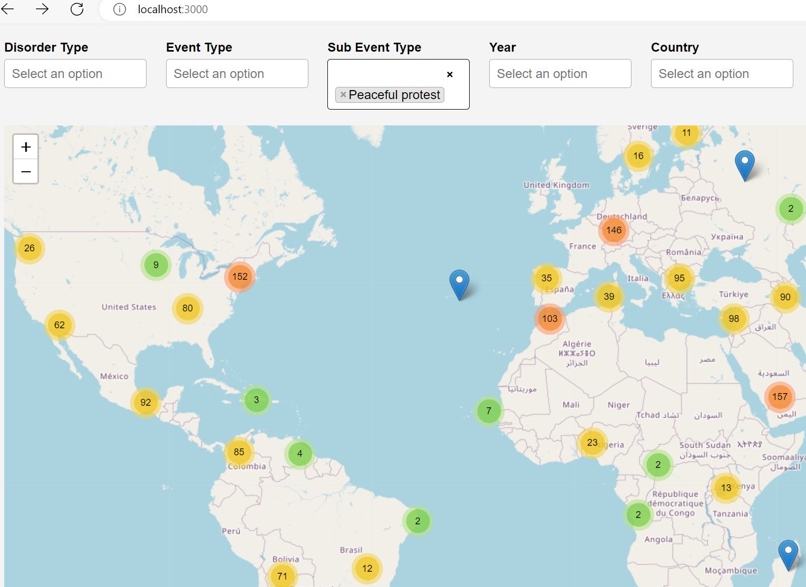
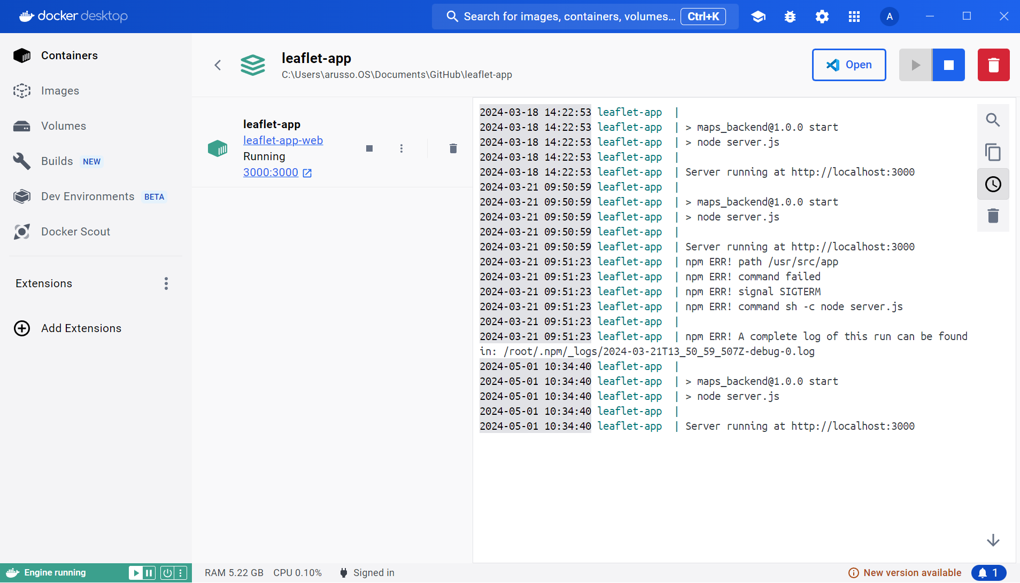
-Systems – ACLED COD Visualization with Docker https://acled-codviz.itos.uga.edu
Example: A web tool may render the COD for P-coding benefits at small scales

Slide 3
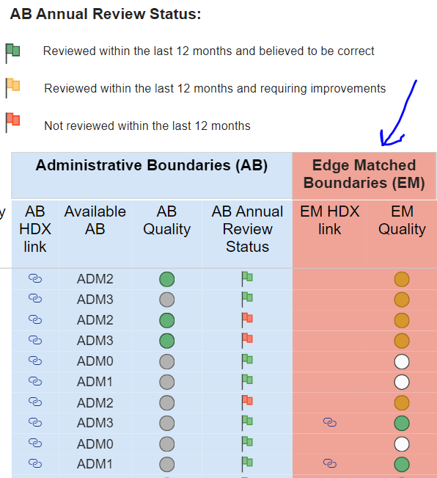
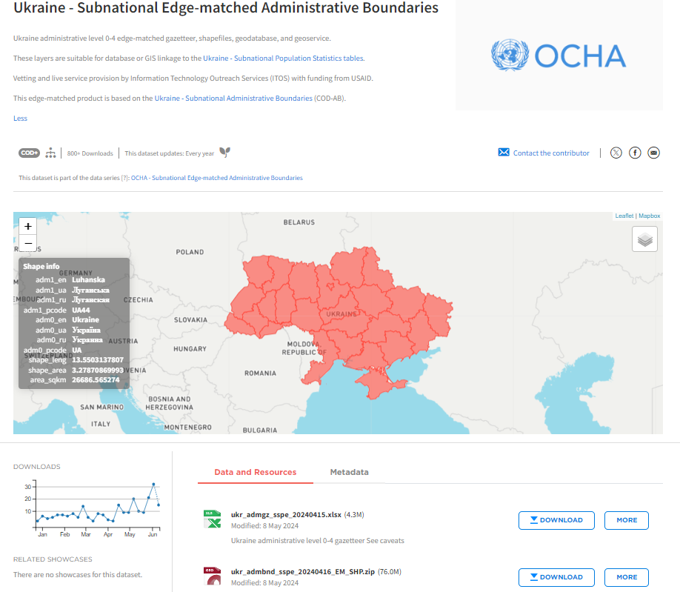
-See the https://cod.unocha.org COD Portal for the list that includes an HDX dataset page and location of data for download or connection to live services: https://codgis.itos.uga.edu/arcgis/rest/services/COD_External_Edgematch
COD EDGE-MATCH FAQ:

Slide 4
….Process
COD EDGE-MATCH FAQ

Slide 5
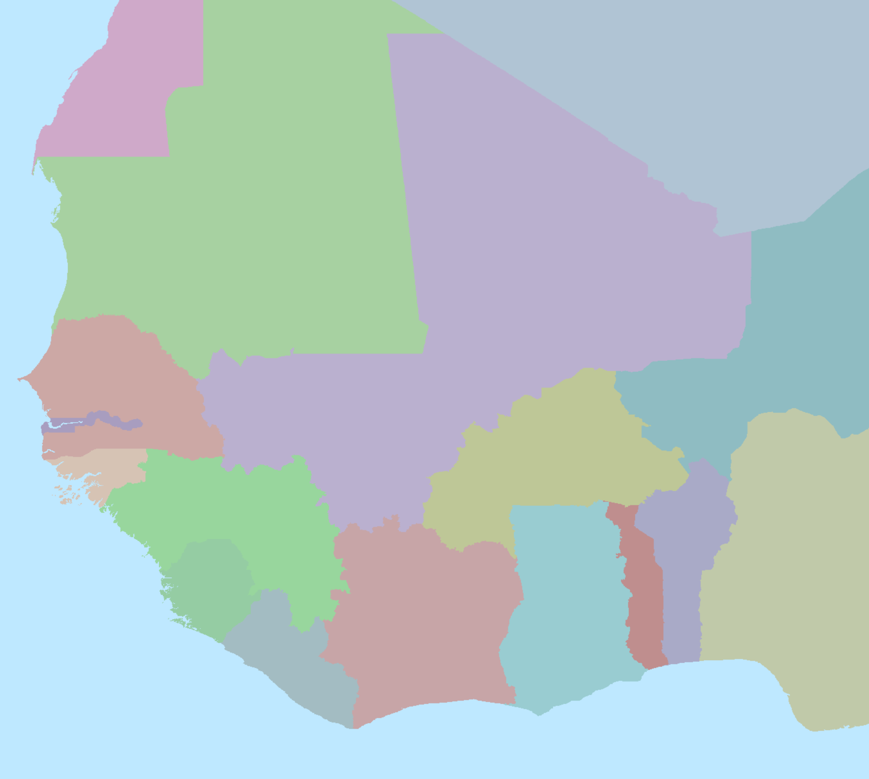
Edge-matched COD Creation
Replacing a Dataset’s National Borders with UN Edge-matched Borders

Slide 6
Edge-matched COD Creation
Replacing a Dataset’s National Borders with UN Edge-matched Borders

Slide 7
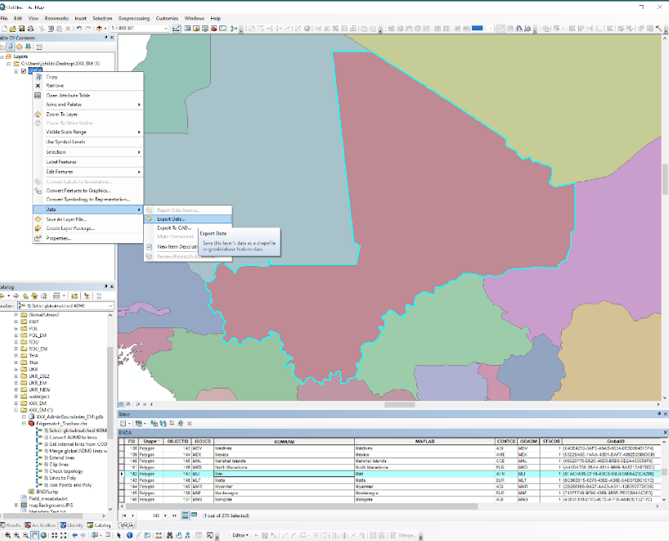
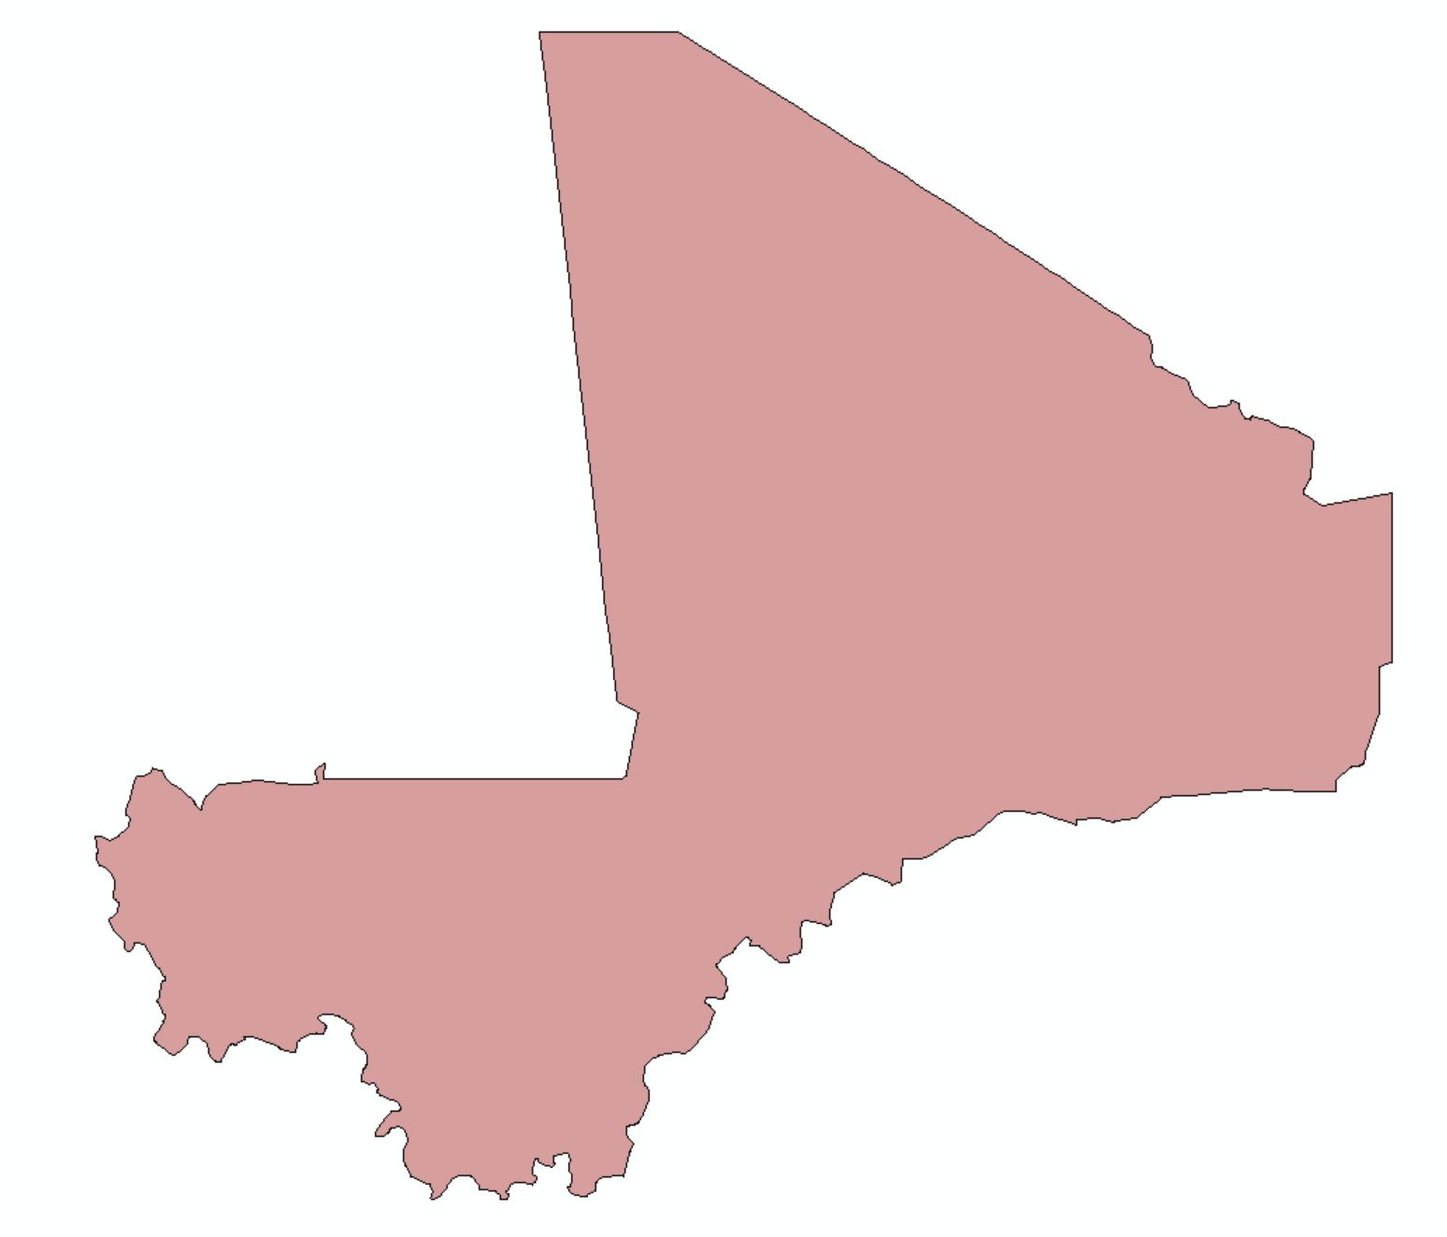
1) Export the UN Borders
First, an export is made of the country from the United Nations Geo Hub global Admin0 polygon layer.

Slide 8
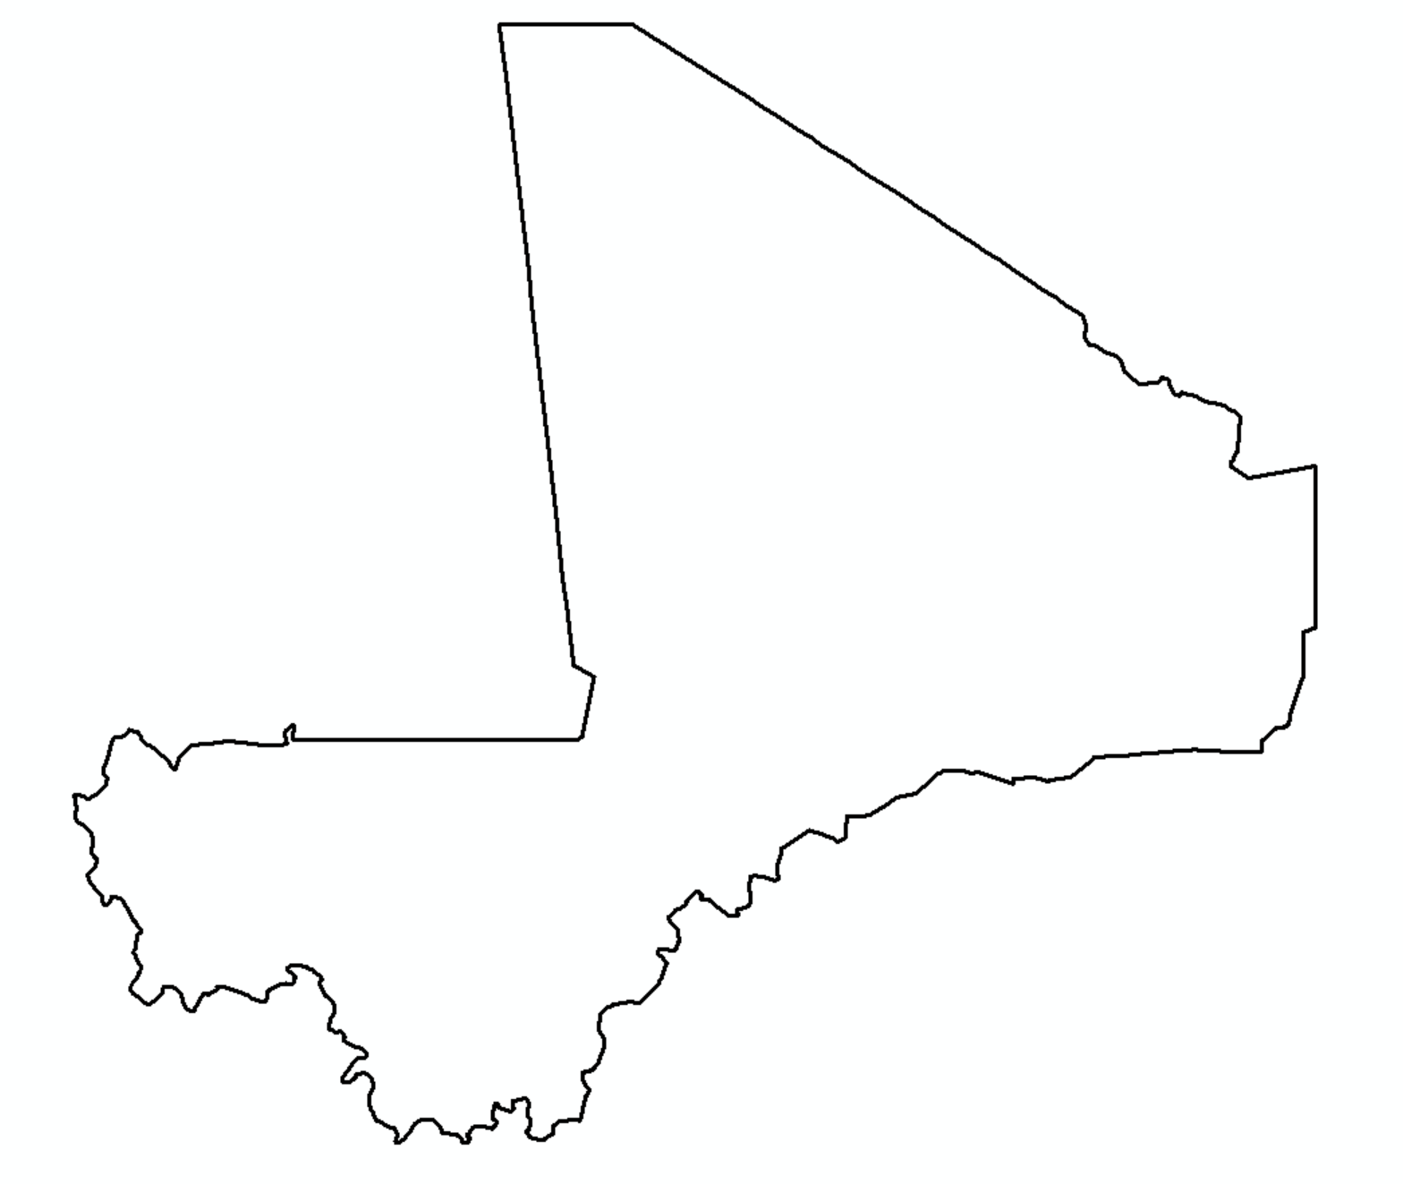
This polygon export is converted to lines.

Slide 9
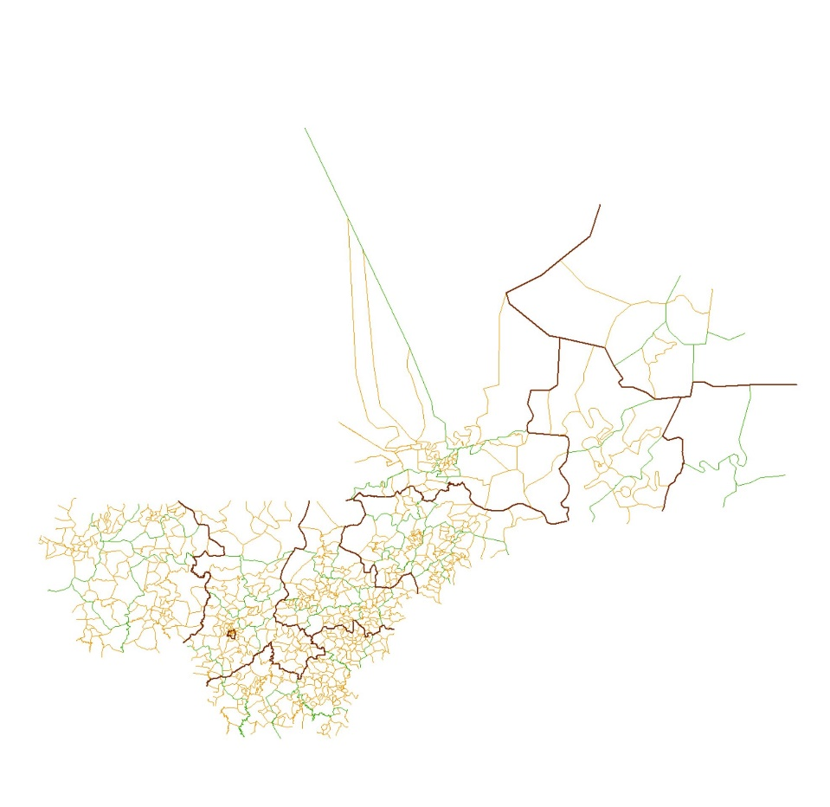
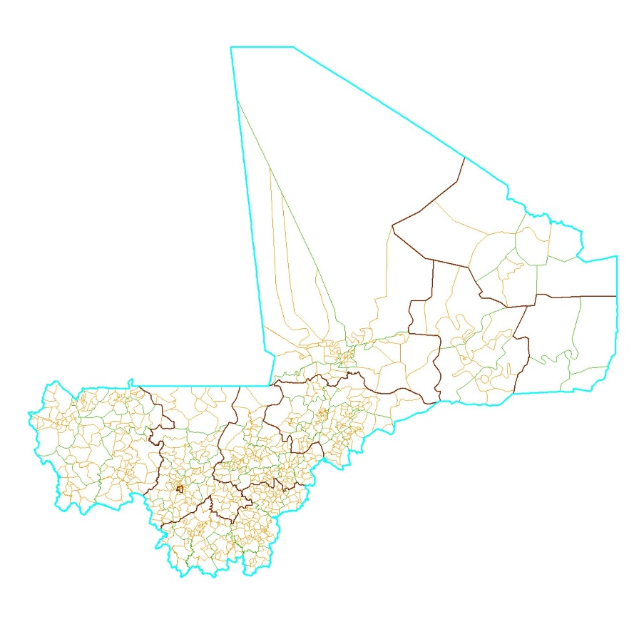
2) Merge Admin0 lines with internal COD lines
A copy of the COD lines layer is made, then its national borders (attributed as ‘adminLevel’ “0”) are removed.
DELETE

Slide 10
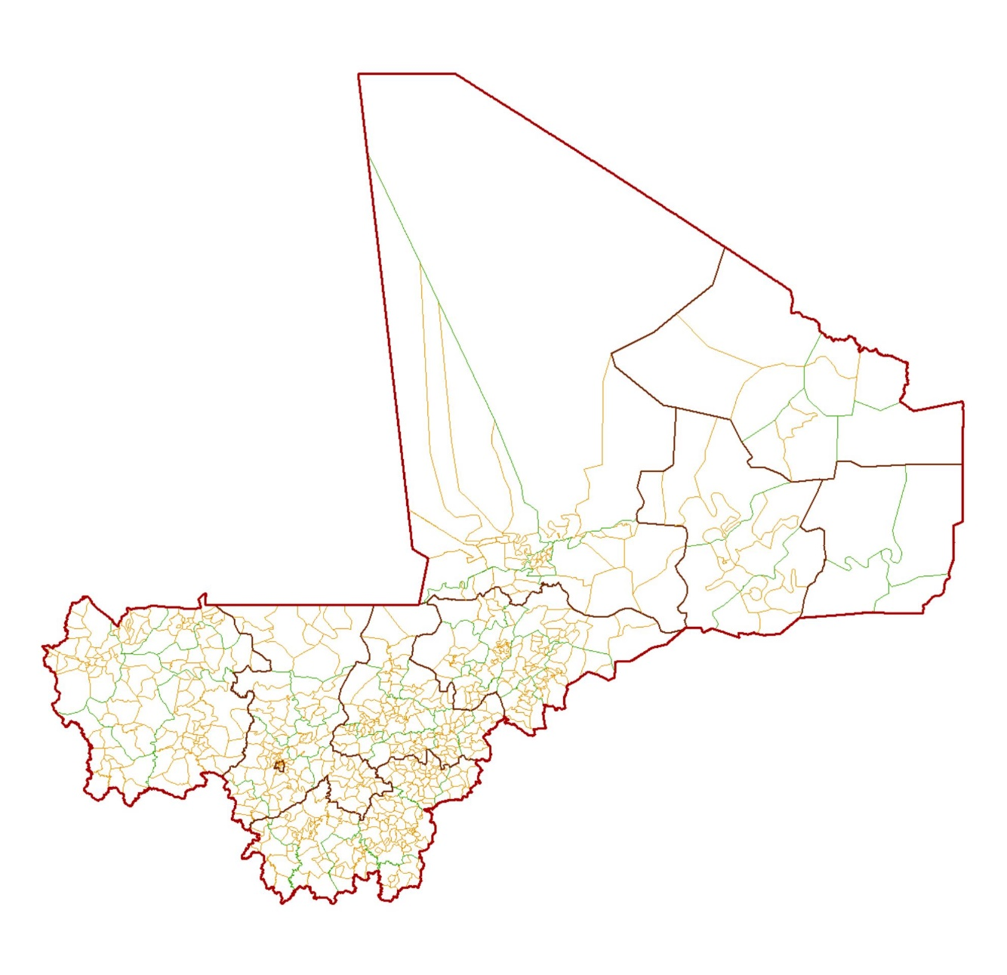
The lines layer created from the global Admin0 is then imported into the COD lines.

Slide 11
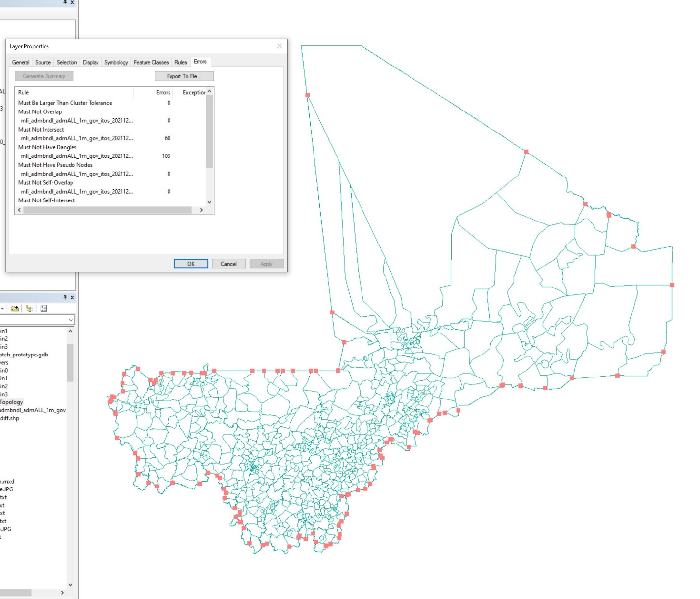
A topology check is created, revealing where the internal lines overlap or fall short of the new Admin0 border.

Slide 12
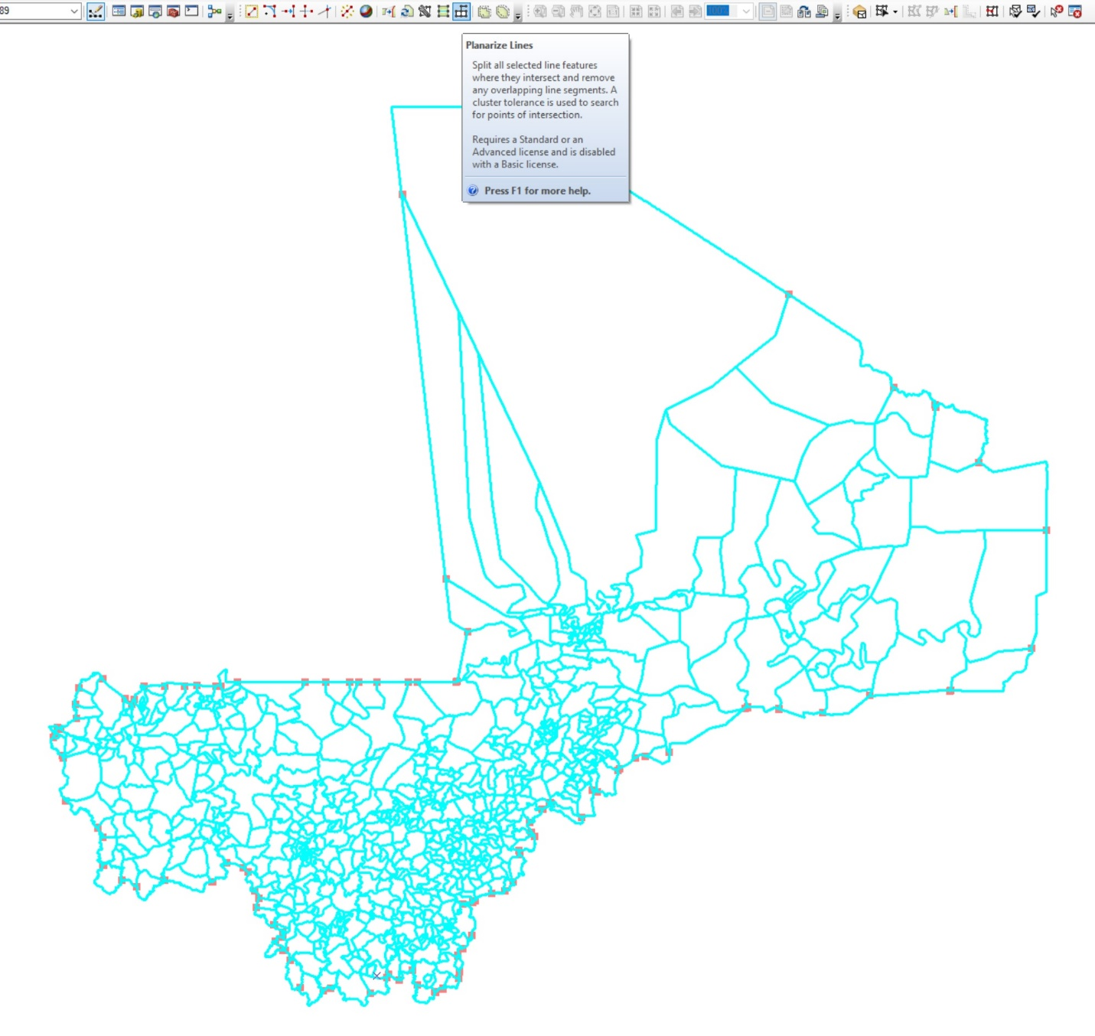
Overlap errors are fixed by using the ‘Planarize Lines’ tool, splitting the line at the point the two layers overlap.

Slide 13
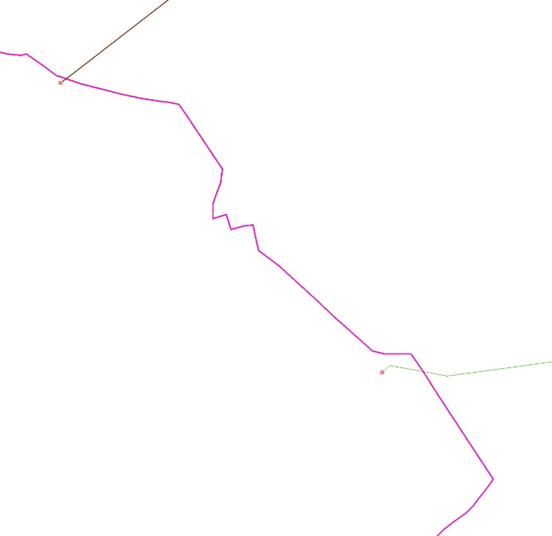
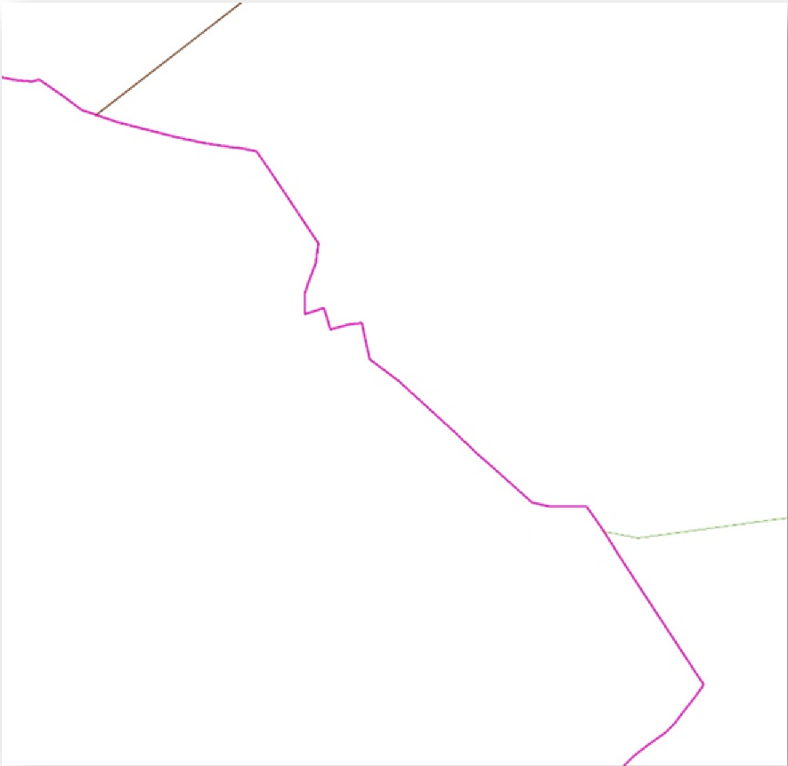
Any line segments extending past the national border are then clipped.

Slide 14
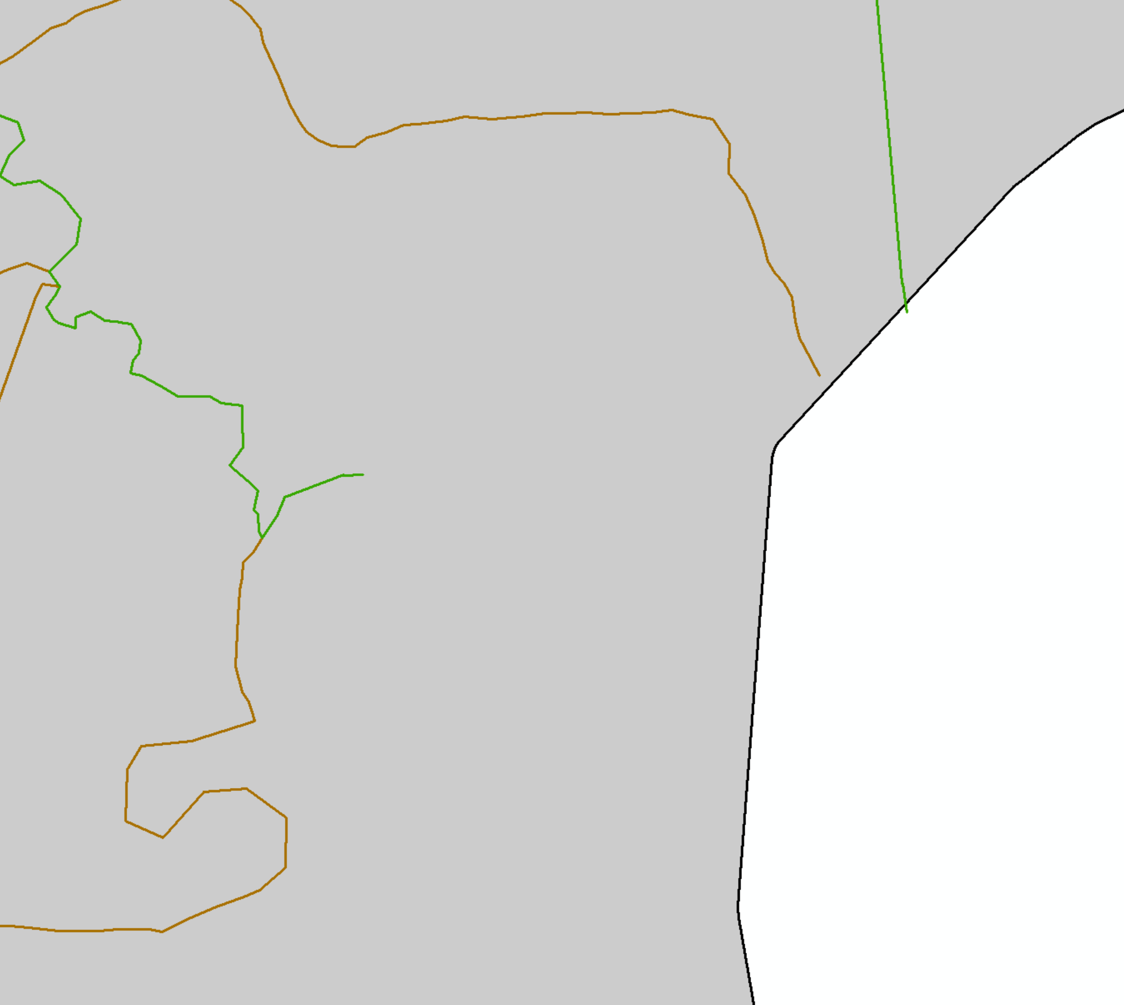
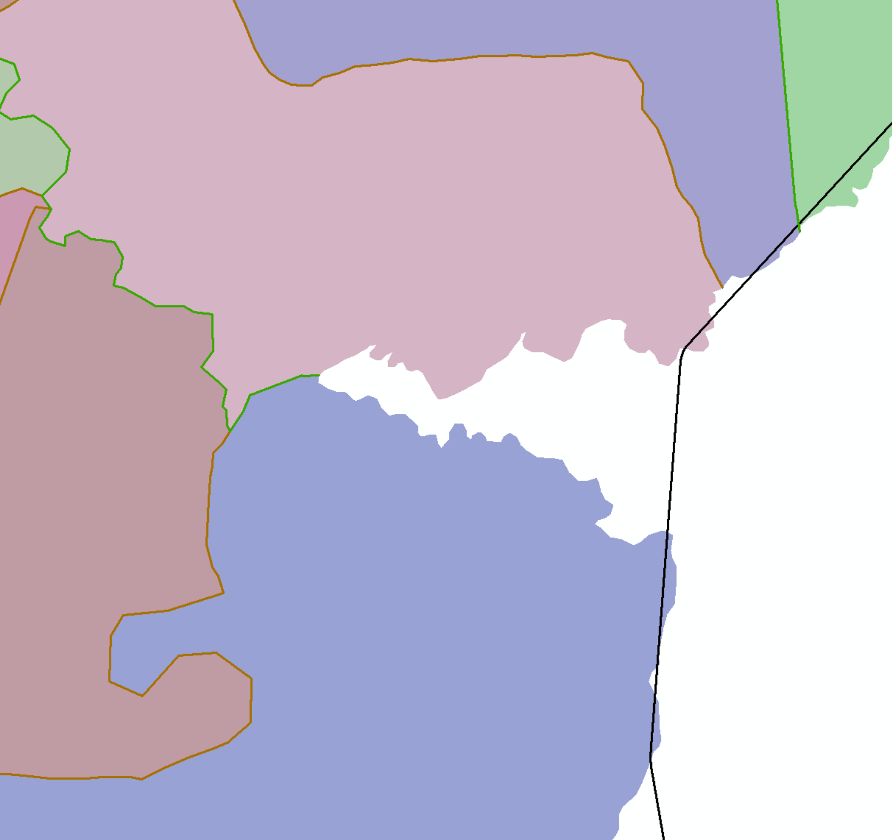

When lines fall short, care is needed to not simply extend the line straight forward to the boundary but to determine where the border would logically continue.
COD Admin3 layer used for reference

Slide 15
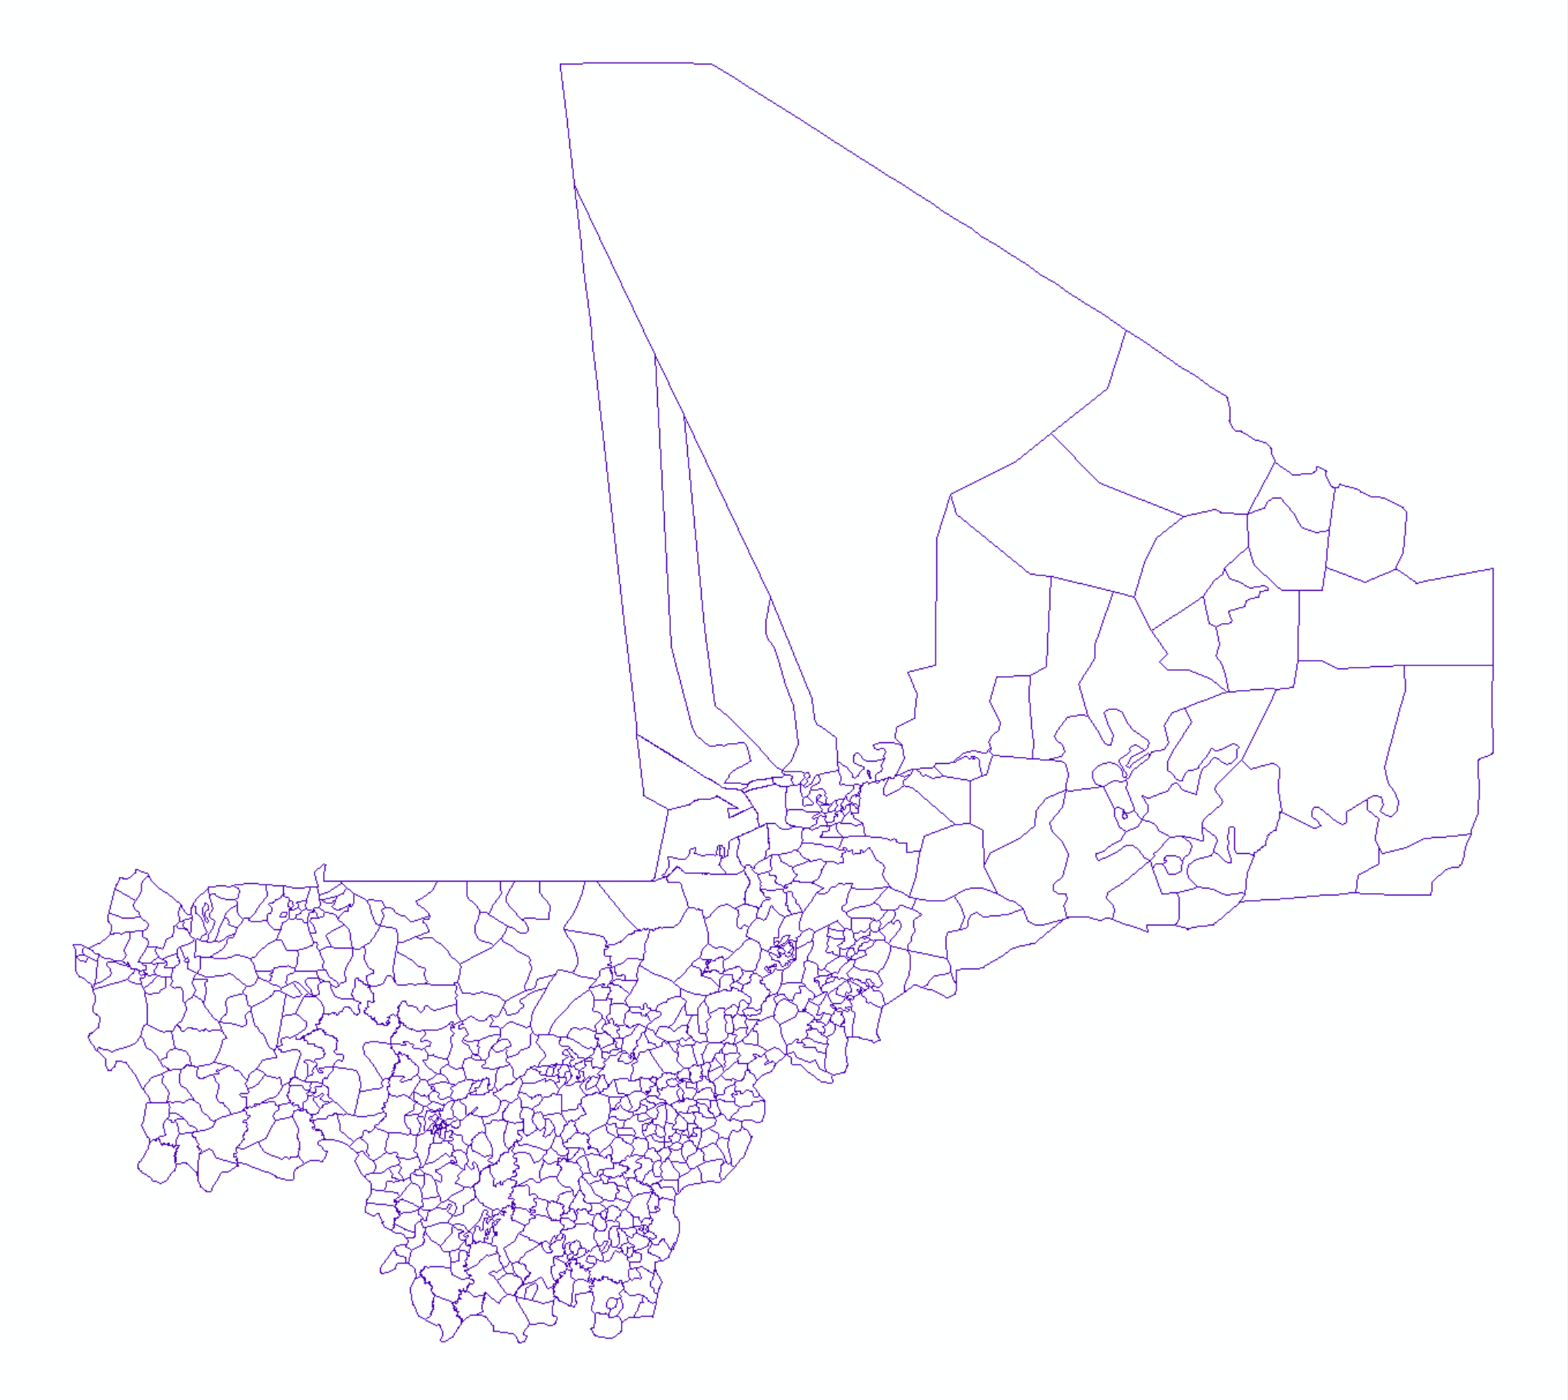
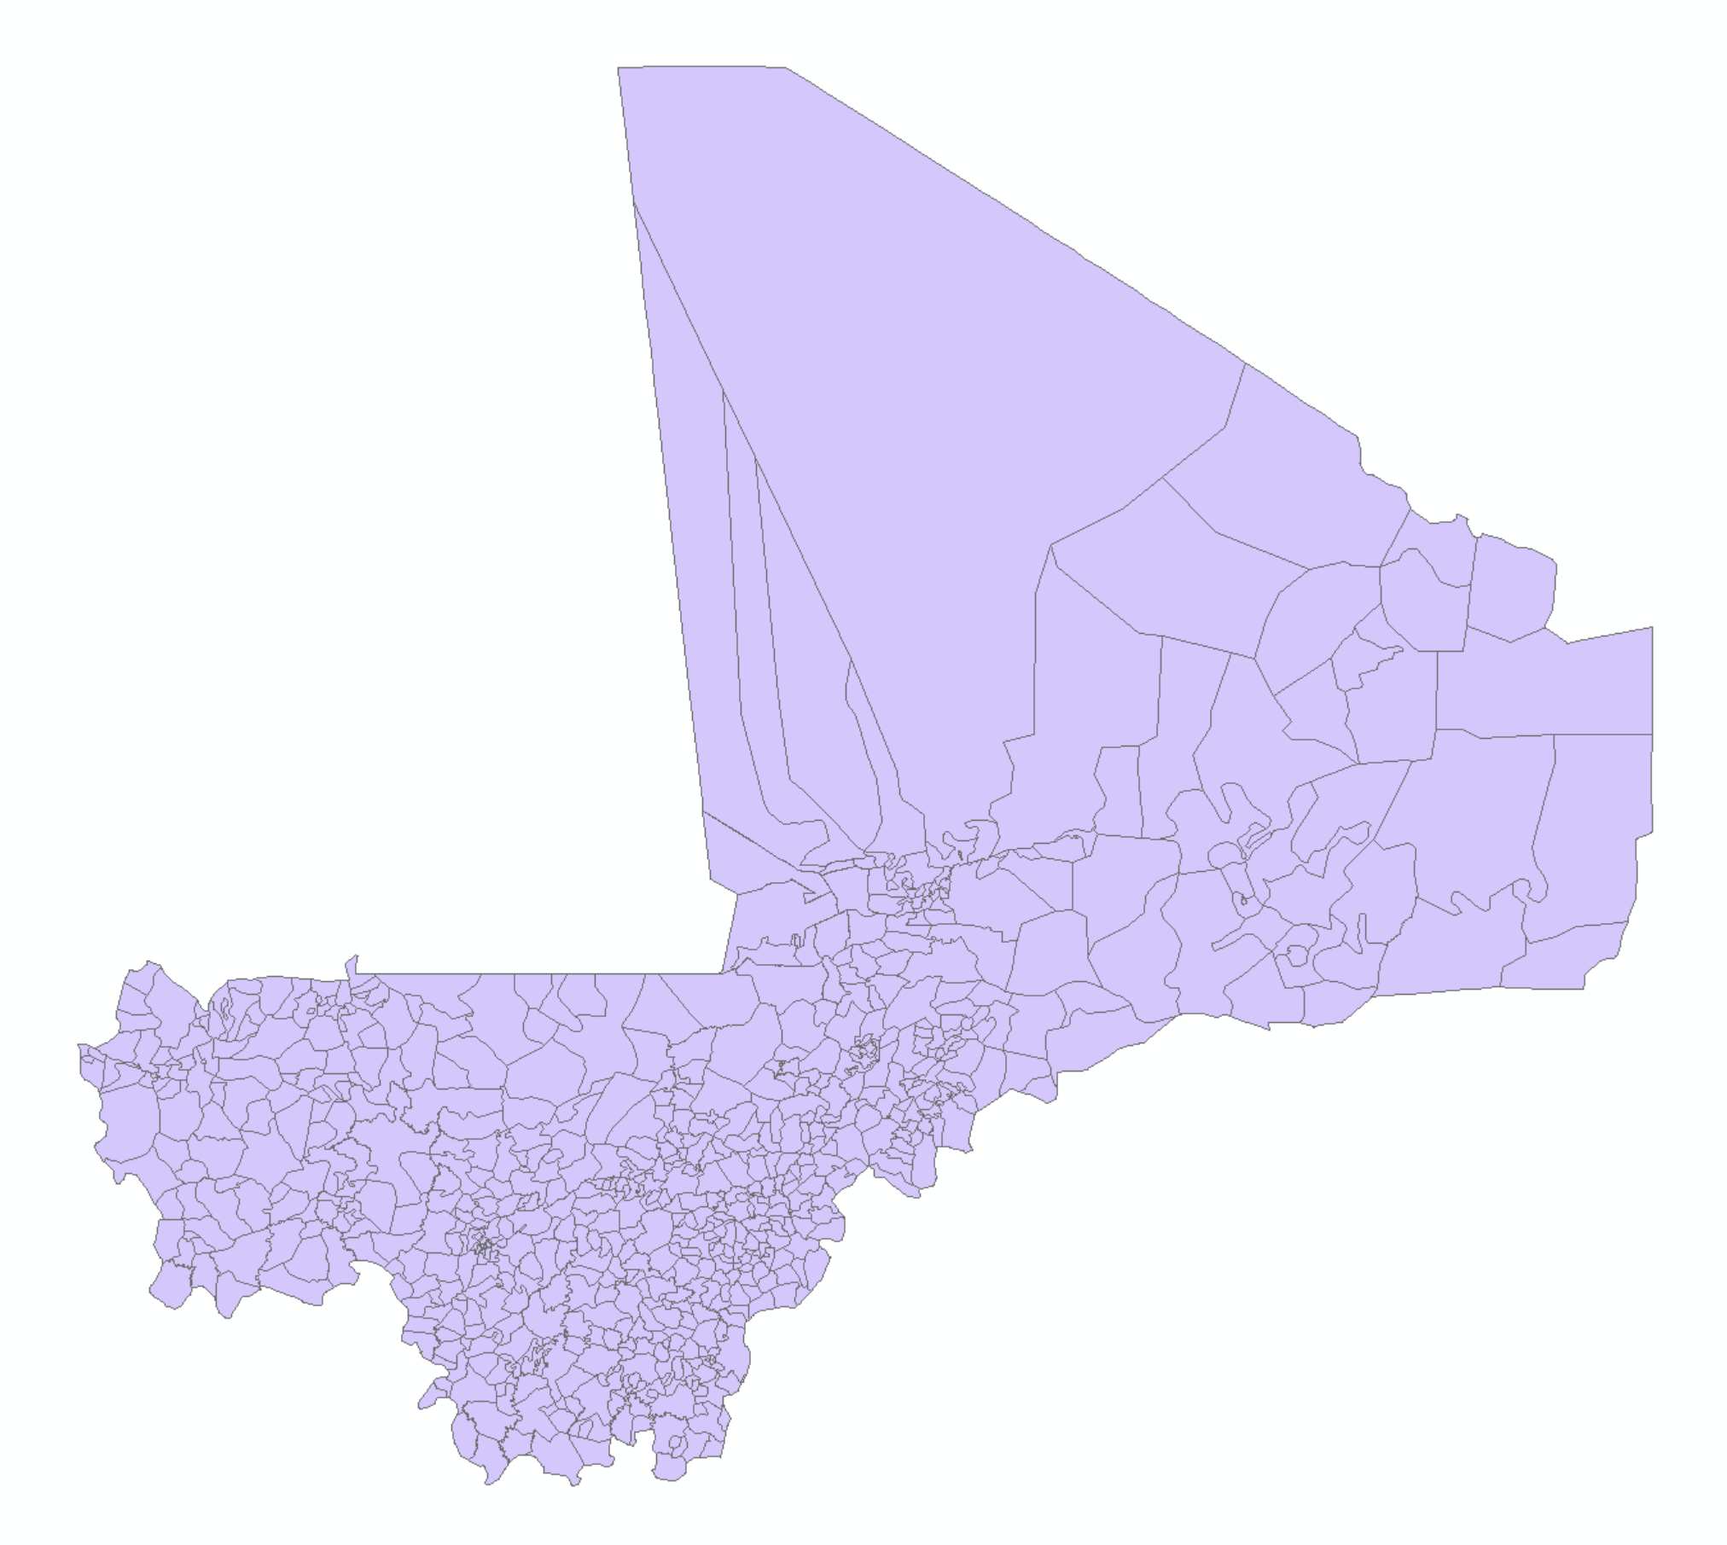
3) Convert lines to polygons
Once the lines layer is free of topological errors, it is converted into polygons.

Slide 16
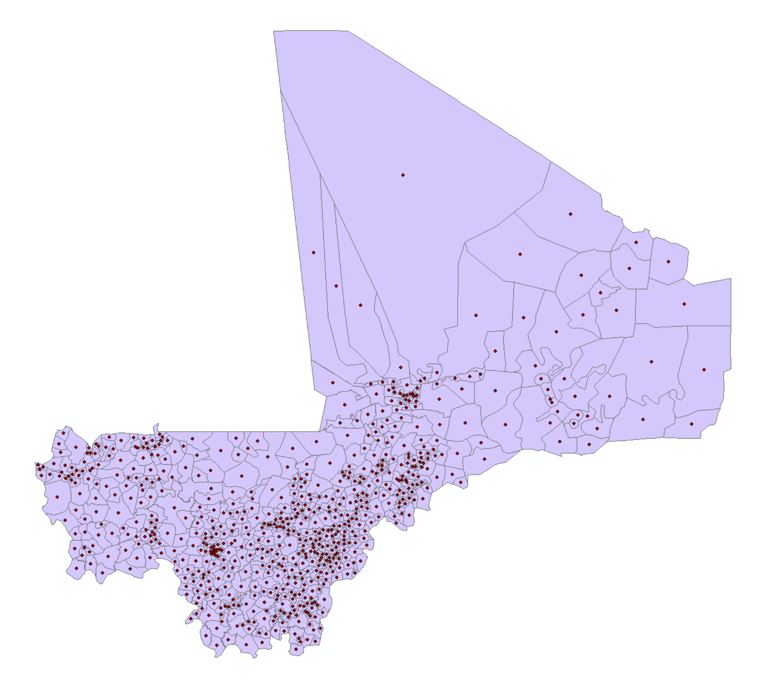
The polygon layer created from lines has blank attribution, so a spatial join is done with points made from the COD polygons.

Slide 17
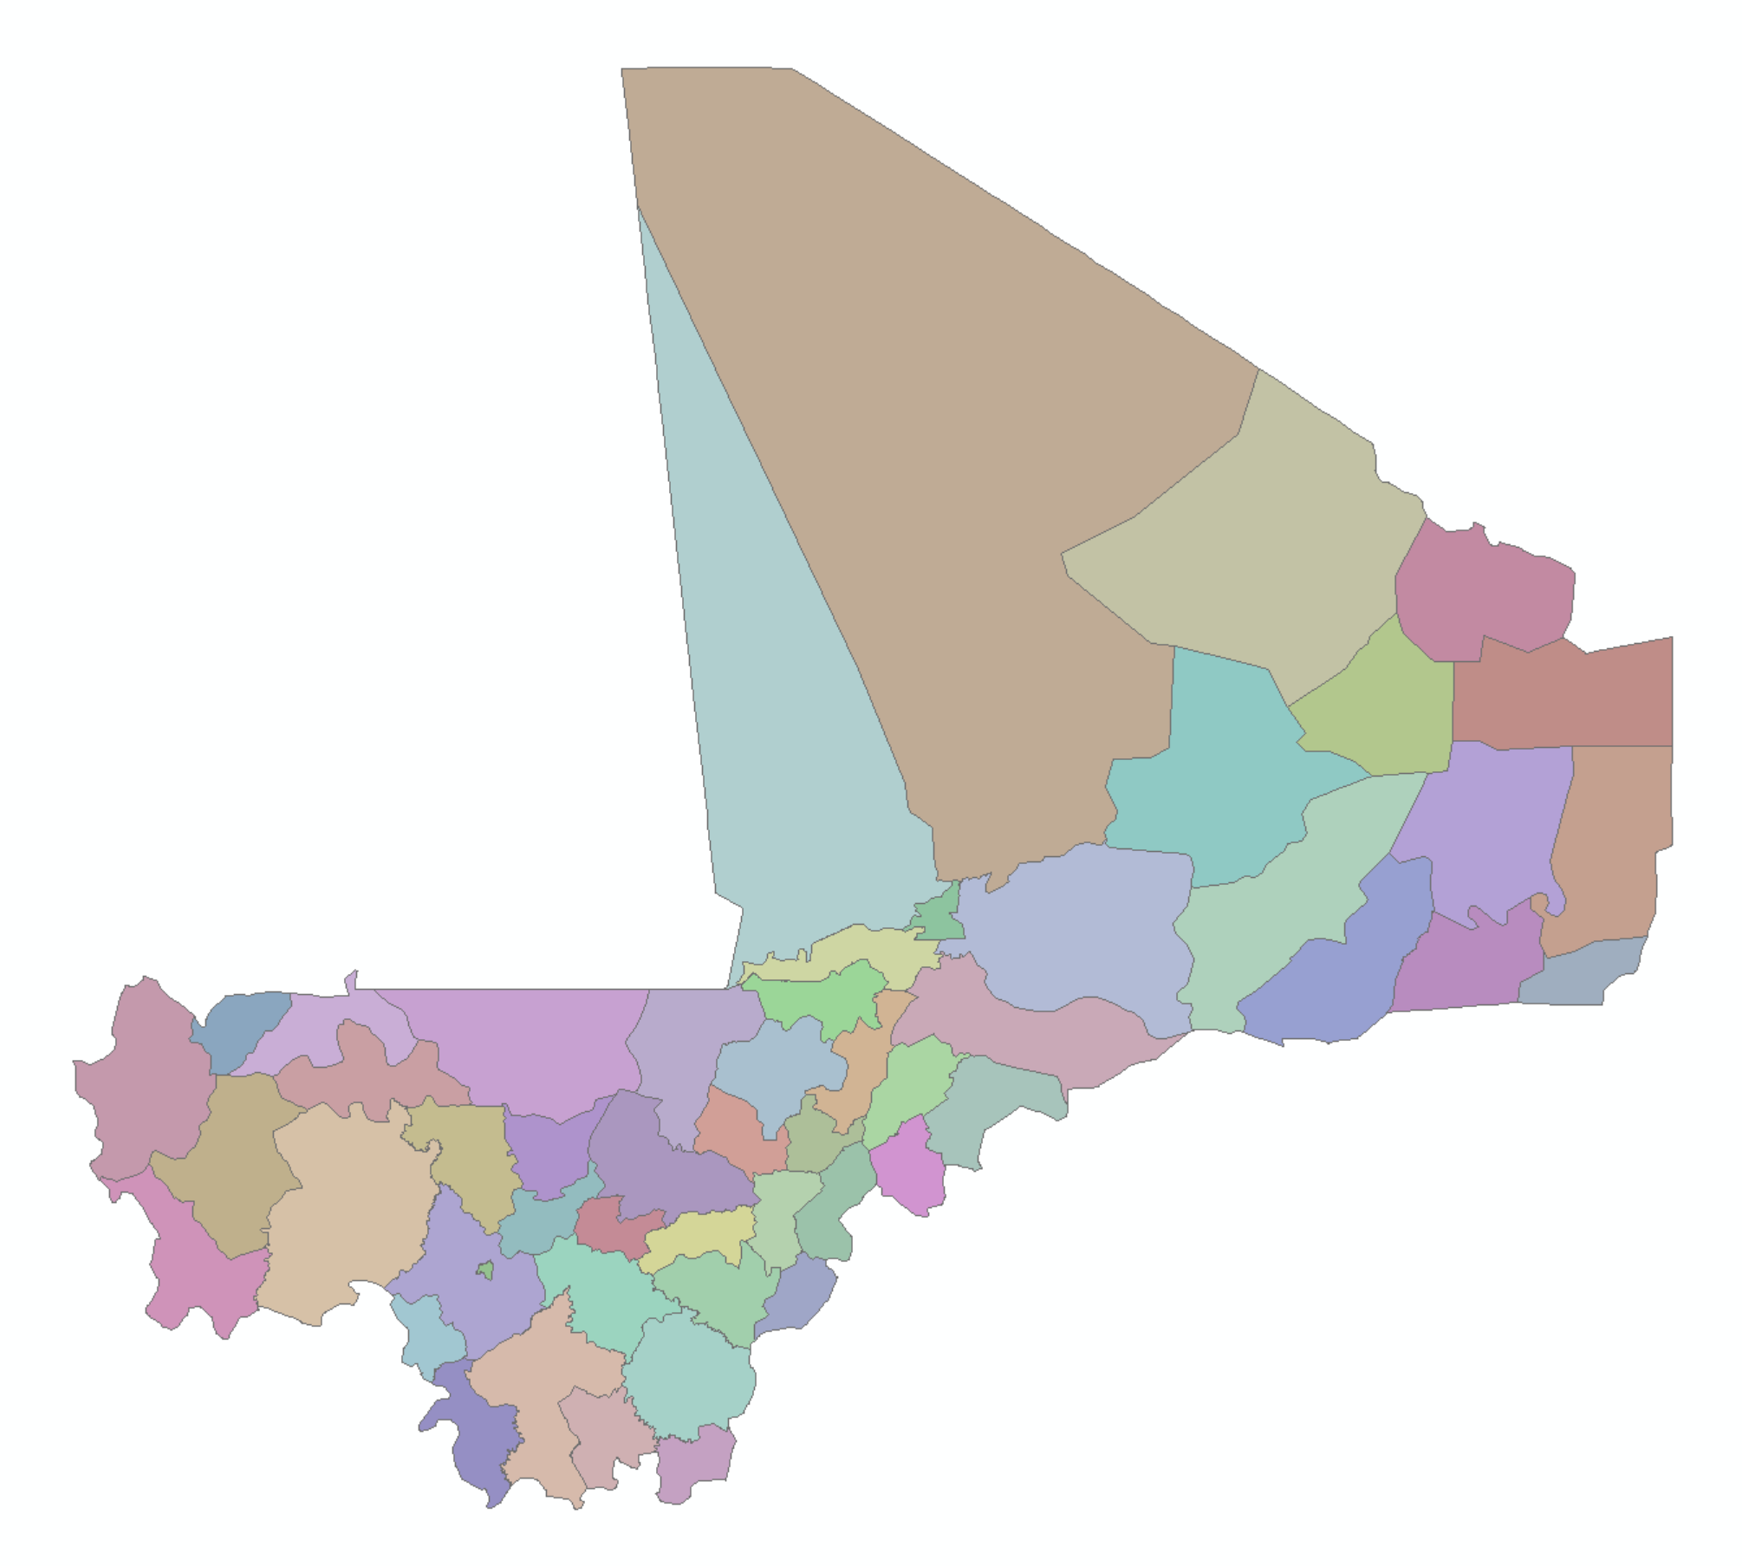
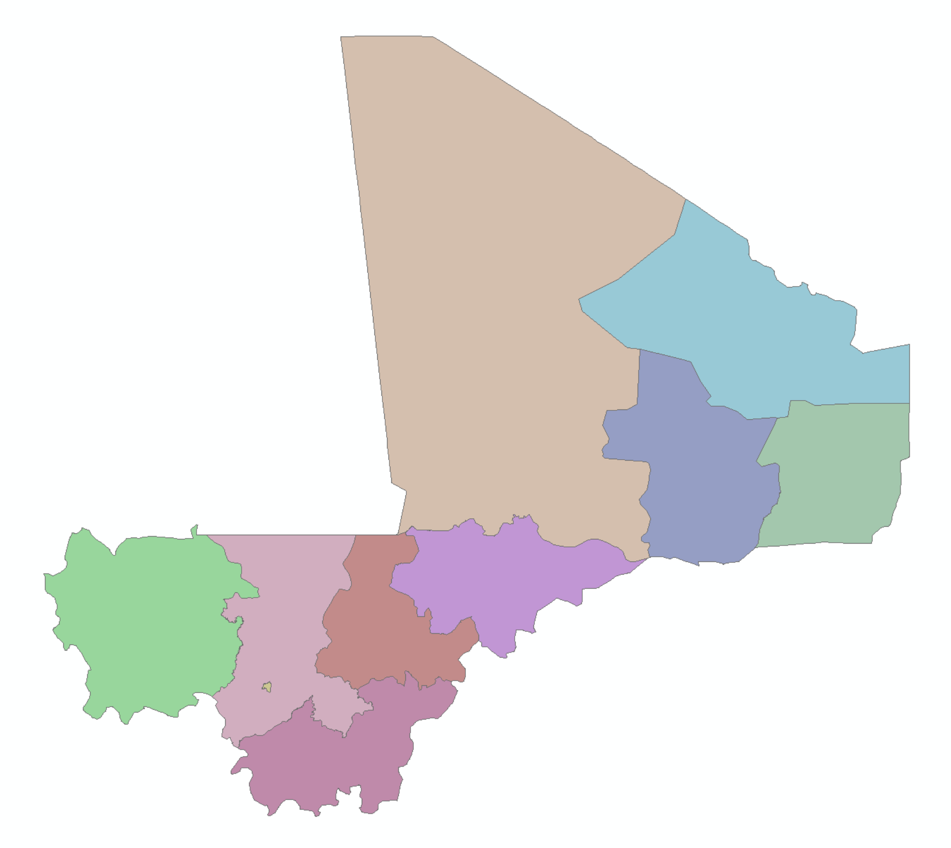
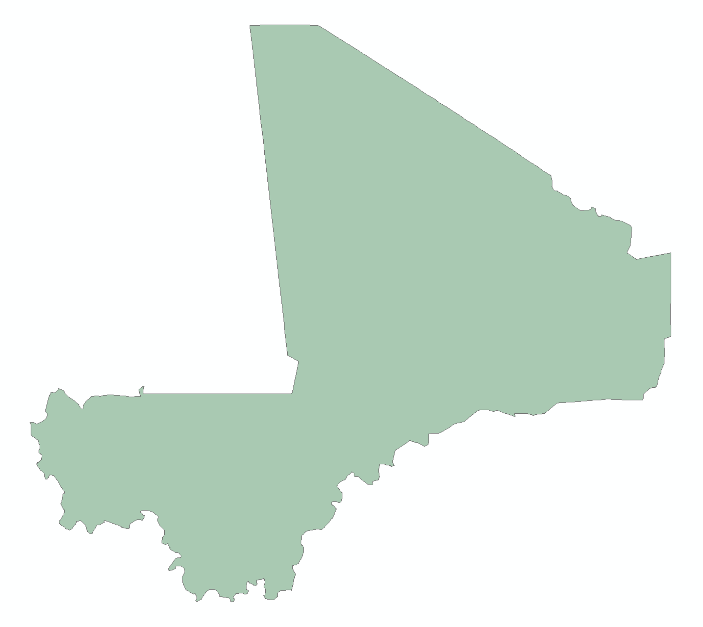
All multipart polygons are dissolved to match the number of admin features in the COD-AB.
This layer is then dissolved to create the higher administrative boundary layers.

